Slide 1
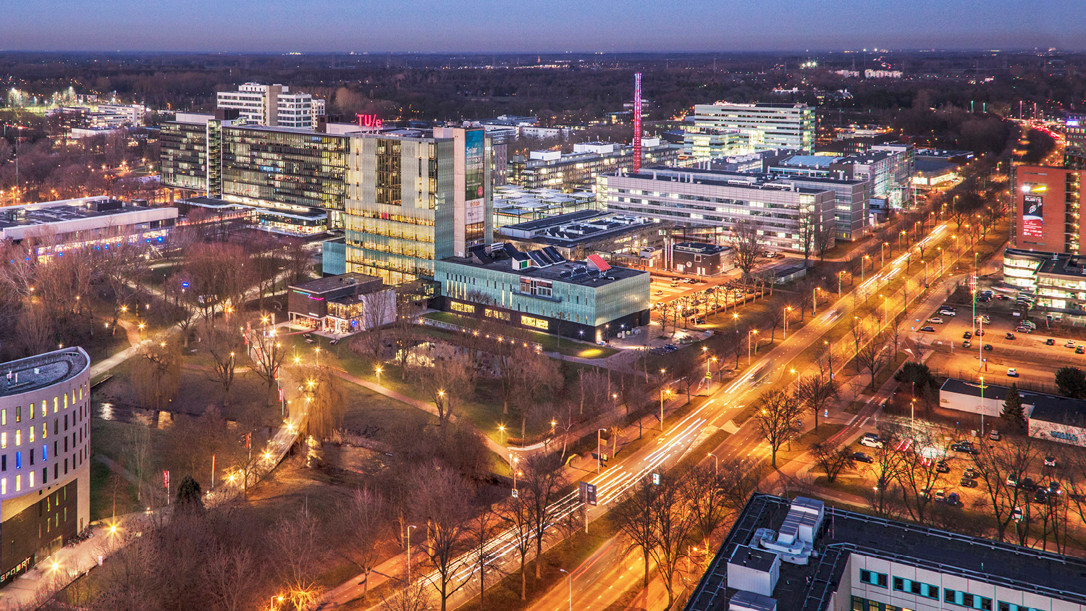
Progress Meeting Diploma Thesis Project Supersaturation-induced gas evolution bubble detection
03.03.2022
Josefine Gatter
Chemical Engineering and Chemistry, Chemical Process Intensification
Notes:
17:27

Slide 2
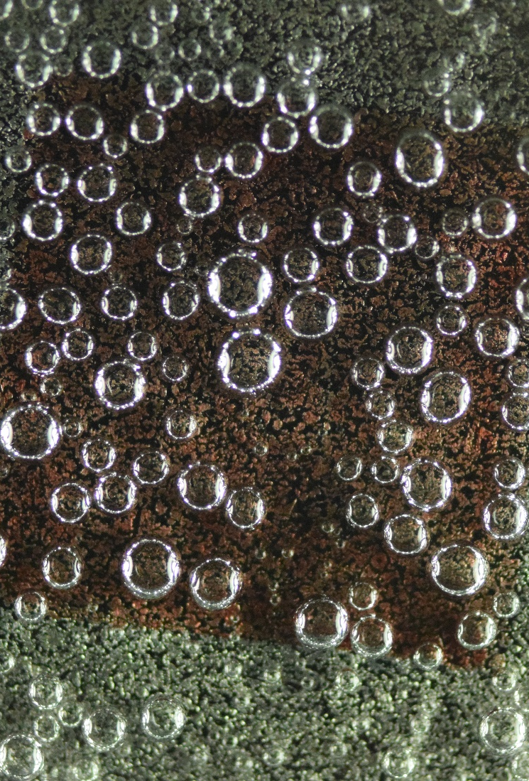
Research question
How can one quantitatively analyze the bulk gas bubble evolution of a supersaturated liquid?

Slide 3
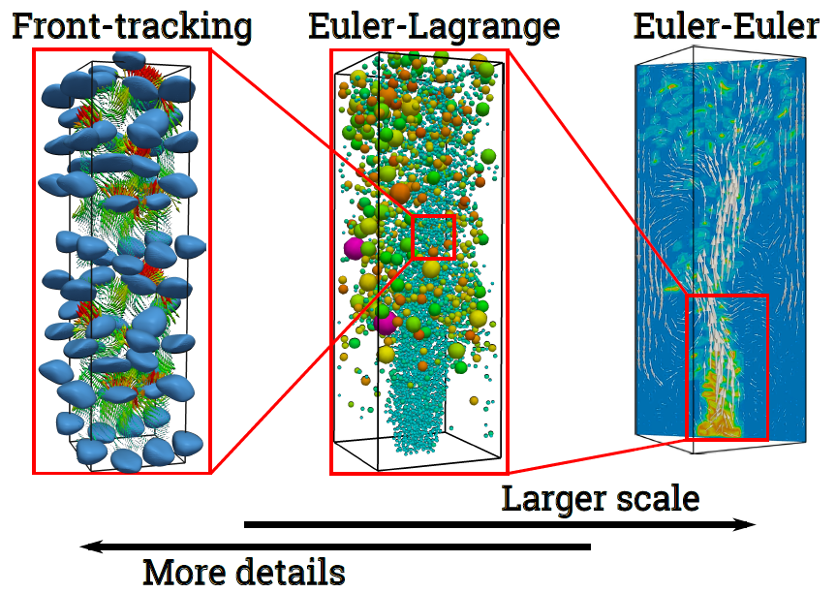
Motivation
Bubble nucleation
Industrial applications
Electrolysis
Fermentation
Mass transfer liquid / gas interface
Characterization of Bubble Nucleation on a surface
Design electrolysers
Improvement of (CFD-type) models
Image taken from: Battistella, A. (2021). Hydrodynamics, Mass Transfer and Phase Transition in Bubbly Flows
Notes:
Mass transfer @ interface → optimize processes
Necessary characterize
CFD = Computational Fluid Dynamics:
schematically see on right
Aless. Covered in his thesis: Euler-Lagrange: Discrete bubble model (DBM)
Based on: Assumptions due to limited information on physical/chemical phenomena, f.i. on bubble nucleation
Characterize in order to account for those phenomena → improve models

Slide 4
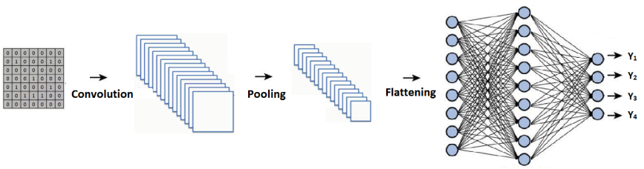
Methods
Experimental
Perform measurements on supersaturation-induced bubble nucleation
Development
Set up a Deep Learning-based method for the detection of nucleating bubbles
Verify performance using benchmark data
Analysis
Compare the performance of different network architectures
Analysis of bubble detections
Picture taken from: Maeda-Gutierrez et al., (2019), Comparison of Convolutional Neural Network Architectures for Classification of Tomato Plant Diseases
Notes:
3 main parts
.. Where gas bubbles form on a substrate
.. & analyze provided detections

Slide 5
Characterization of the nucleation process
Number of bubbles / number of nucleation sites
Bubble size distribution
Growth rate
Detachment size
Detachment rate
Effect of surface properties and structure on nucleation process
Study different experimental settings (e.g. supersaturation ratios)
Comparison to Digital Image Analysis (DIA) from Battistella, A.
Notes:
Info: obtain in order to char.
Examine
Compare outcome from detection to..

Slide 6
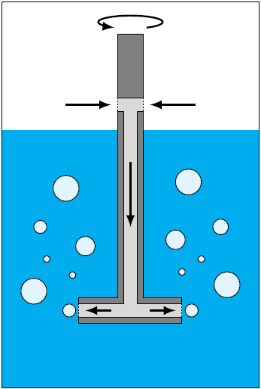
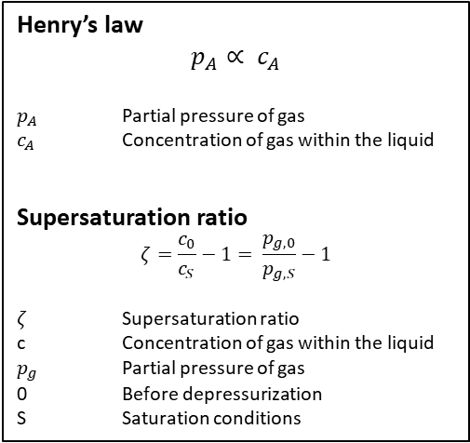
Bubble Nucleation Setup
Henry’s law
$$p_{A}∝ c_{A}$$
$p_{A}$ Partial pressure of gas
$c_{A}$ Concentration of gas within the liquid
Supersaturation ratio
$$ζ=\frac{c_{0}}{c_{S}}−1= \frac{p_{g,0}}{p_{g,S}}−1$$
$ζ$ Supersaturation ratio
c Concentration of gas within the liquid
$p_{g}$ Partial pressure of gas
0 Before depressurization
S Saturation conditions
Measuring vessel
Source: Battistella, A. (2021). Hydrodynamics, Mass Transfer and Phase Transition in Bubbly Flows
Gas injection propeller
Notes:
2 vessels
Mixing: preparation solution (water saturated with CO2)
Measuring vessel: metal plate; filled; optically observe bubble formation
Supersaturation attained: lowering pressure in meas. Ves.
Phenomenon: described by henrys law
Amount dissolved gas in liquid proportional 2 its part. Press above liq.
C: quantity of excess gas dissolved in liquid vs. equilibrium conc.

Slide 7
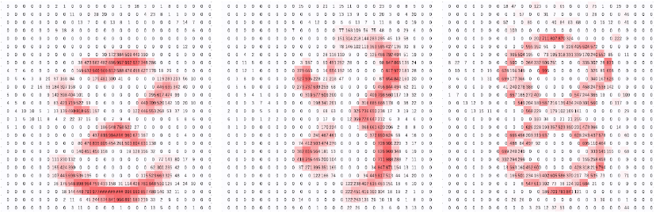
Deep Learning tool Convolutional neural network (CNN)
Annotation / GT
Computer vision (Autonomous driving, facial recognition, …); Natural language processing; Speech recognition
Image recognition, classification, segmentation, reconstruction
Extract features with convolution kernels/filters → Feature map
Flatten
Classification via NN/dense layers
Prediction
Picture taken from: Yamashita et al. (2018). Convolutional neural networks: an overview and application in radiology
Notes:
Applications
Specific Tasks CNN can tackle for such appl.:
Goal OD: min. difference output (pred) & ground truth (annot)
detecting patterns → “visualize” features of given object = Feature map
Image of 8, represented by matrix of pixel values; different so called filters/kernels → highlight different patterns
After Feature extraction → f. extracted into normal NN (classification) → based on feat., decision made if bub or not

Slide 8
Deep Learning tool Transfer Learning
Annotation / GT
Pretrained on large dataset: Learn generic features
Training with small, custom datasets
Tensorflow Object Detection (TFOD) API framework
TFOD Model Zoo
MS COCO Dataset
Custom dataset: artificial images (based on bubble instances from real images)
Prediction
Notes:
- advantage
Zoo: provides numerous models, vary architecture
(Microsoft common objects in context: 330 000 images, 80 object categories, 1.5 Mio object instances
Artificial images: randomly placed on bg; while creating: automatically saves annotation box

Slide 9
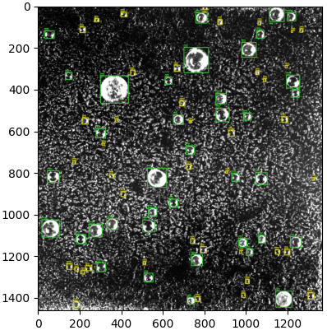
Validation Detections on artificial image
Notes:
Want to achieve:
Bounding boxes
Yellow: mark small bubs
Green: medium/large size

Slide 10
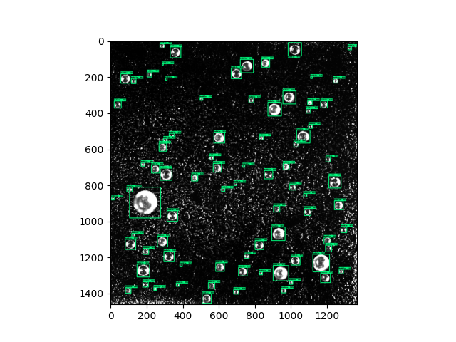
Object Detection Model performance Important influences
1. Artificial training images
Exact annotation of bubble instances
Data augmentation
→ Fit of bounding box annotations
2. Post processing
Adjust detection score threshold
Exclude partial detections
Notes:
Data aug: blur, resize, rotate
Cause loose fit of annotation box
If Net learns smth incorrectly → detection inaccurate
Partial Det: distort detected bubble size

Slide 11
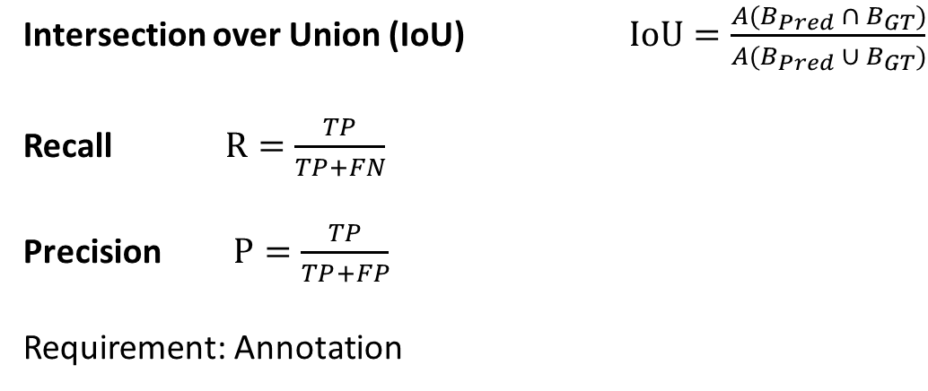
Object Detection Model performance Evaluation Metrics
Intersection over Union (IoU) $IoU=\frac{A(B_{Pred} ∩ B_{GT})}{A(B_{Pred} ∪ B_{GT})}$
Recall $R=\frac{TP}{TP+FN}$
Precision $P=\frac{TP}{TP+FP}$
Requirement: Annotation
Notes:
Quantify Quality of detection
Define metrics
IoU: measure of overlap (Annot. & Pred)
Good model: Prec & Rec → 1
Req. for eval.: Annotation available
1. Test model on annotated data
2. Use model for new datasets without annot.

Slide 12
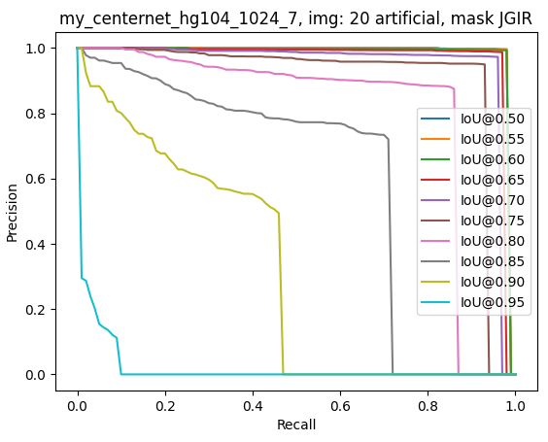
Validation Artificial images
Notes:
Performance 1 model → observed P-R-curve
Depending Different IoUs and detection scores
Well performing model: Prec + Rec → 1
Perfect performance: line in top right corner
Model performs very well for IoU up to 0.8 (80% overlap)
Only for very high required overlap (95%) no sufficient performance
For easier comparison (models with each other):
Area under curve summarized → mAP (one value)

Slide 13
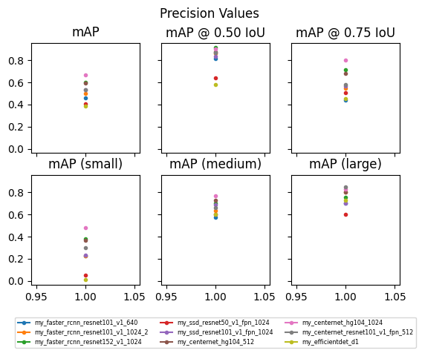
Establish Object Detection Model
Compared different nets
Architectures
Training time
Trade-off: Accuracy & Speed
Decided on one net structure
(Centernet_Hourglass)
Optimized training images
Optimized training settings
Notes:
diff. CNNs from TF Model Zoo
- Comparison with mean average precision
Plot of different mean precision values (area under P-R-curve)
Performances Clearly differ
Trained chosen net again

Slide 14
Application to experimental images: Detections Visualization
t = 2 min
t = 10 min
t = 30 min
Notes:
Detected bubbles from final model
Time series photos of nucleation process
substrate = porous steel plate (pore size 40 micro m)
Supersaturation ratio of 0.16

Slide 15
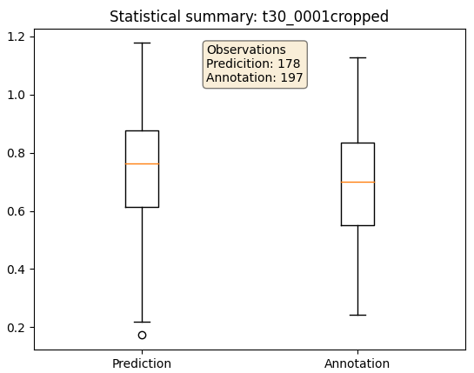
Data Analysis Statistical summary – Bubble diameters [mm]
Notes:
Statistical summaries of bubble size from prediction & annotation
Single real image
Annotated by hand
Check if prediction correct
Minimum
Maximum
Median (middle value in data set)
First & Third quartile (median of lower / upper half of the dataset)
outliers

Slide 16
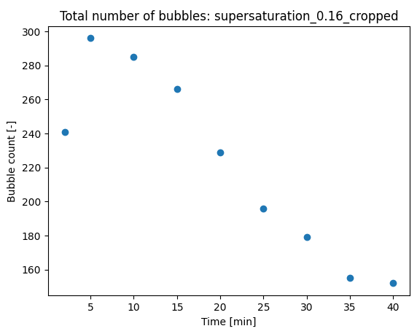
Data Analysis Total number of bubbles / nucleation sites
Nucleation
Growth
Detachment
Notes:
Evolution of total number detected bubs with time
First: leap
Then: decrease of bubs
1) Nucleate / BUT possible Too small 4 detect
2) N bub drops: Detachment / they coalesce

Slide 17
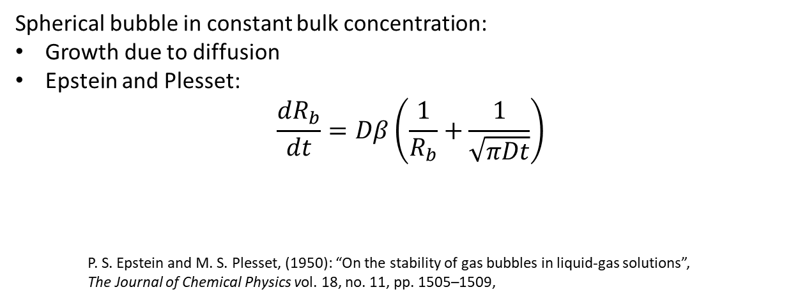
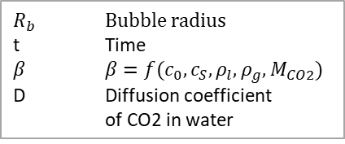
Data Analysis Bubble growth
Spherical bubble in constant bulk concentration:
Growth due to diffusion
Epstein and Plesset:
$$\frac{{dR}_{b}}{dt}=Dβ\left(\frac{1}{R_{b}}+\frac{1}{\sqrt{πDt}}\right)$$
P. S. Epstein and M. S. Plesset, (1950): “On the stability of gas bubbles in liquid-gas solutions”,
The Journal of Chemical Physics vol. 18, no. 11, pp. 1505–1509,
$R_{b}$ Bubble radius
t Time
$β$ $β=f(c_{0},c_{S},ρ_{l},ρ_{g},M_{CO2})$
D Diffusion coefficient
of CO2 in water
Notes:
Theory
Described growth of spherical bubble due to diffusion
Expected bubble grows according to squareroot of time

Slide 18
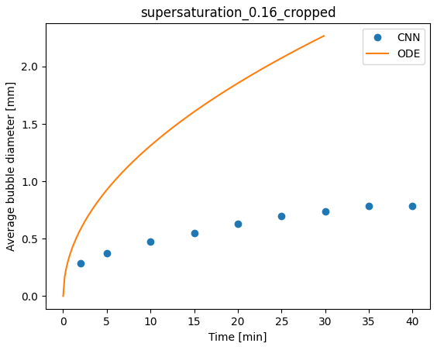
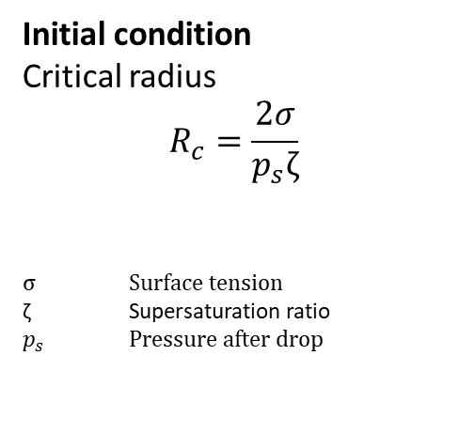
Data Analysis Bubble growth
Initial condition
Critical radius
$$R_{c}=\frac{2σ}{p_{s}ζ}$$
$σ$ Surface tension
ζ Supersaturation ratio
$p_{s}$ Pressure after drop
Notes:
Solved ordinary differential equation
With value Rc as initial condition
Rc = min. size for bubble to grow by mass transfer without dissolving back to liquid
Solution & bubble size deduced from detection

Slide 19
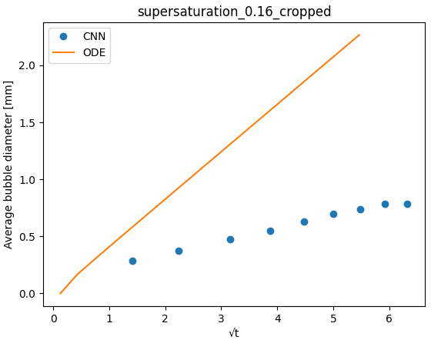
Data Analysis Bubble growth
Lower proportionality:
Non-spherical shape
Convection/advection
Local depletion of CO₂
Notes:
- Plot over squareroot of time: see linear increase of Rb with sqrt of time
Bubbles grow more slowly than correlation predicts:
Due to irregularities / effects that were not taken into account
Local depletion: provoques reduced rate of mass transfer compared to analytical solution

Slide 20
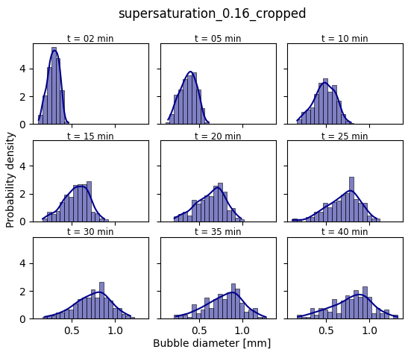
Notes:
Bubble size distribution
Development over time
Probability density function = relative likelihood that bubble has certain size
First: narrow bub size distr.
Small bubbles, grow with similar growth rate
Then: growth; bubs coalesce with each other / detach
Start growing again
→ distribution widens and flattens
Behavior could be observed with DIA aswell

Slide 21
Outlook
Characterization of the nucleation process
Detachment size
Detachment quantification
Model mass transfer at liquid/gas interface with DBM
New parameters in DBM considering nucleation site properties
Notes:
Char. Not yet complete
Out of scope
Interesting
Supply DBM with new param

Slide 22
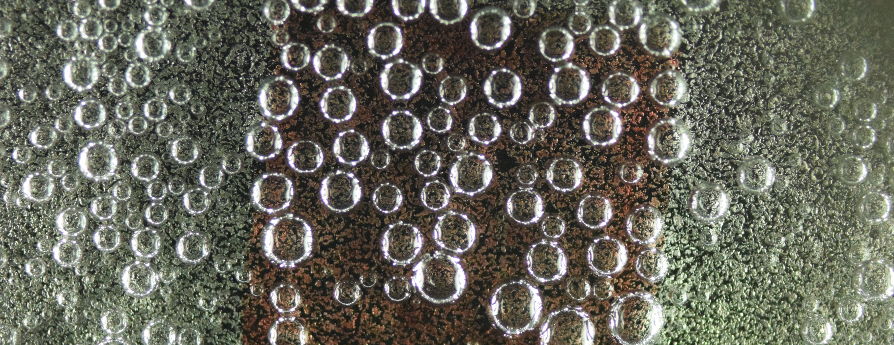
Questions and Discussion

Slide 23
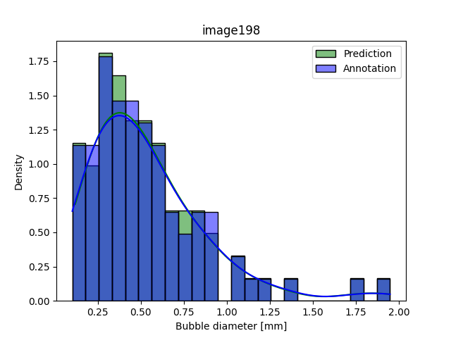
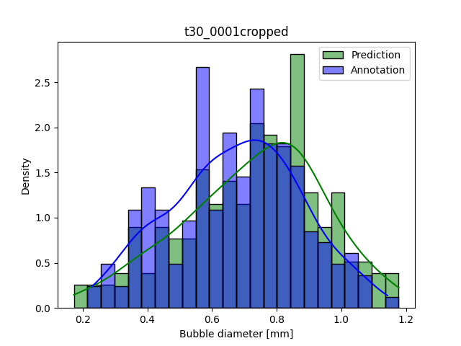
Validation Bubble size distribution
Notes:
bsd deduced from detection of CNN
Comparison to bsd obtained by annotation
left: detected bsd of artificial
Right: real image
Estimate how well net performs
If Trouble detecting certain bubble sizes

Slide 24
Thesis
Characterization of the
nucleation process for supersaturation-induced gas evolution with a Deep Learning-based
bubble detection method

